Slide 1

Establishing a Residential Real Estate Company in Bushwick - Prabu. J
A Data-Driven Approach for Strategic Decision Making
- PRABU.J

Slide 2
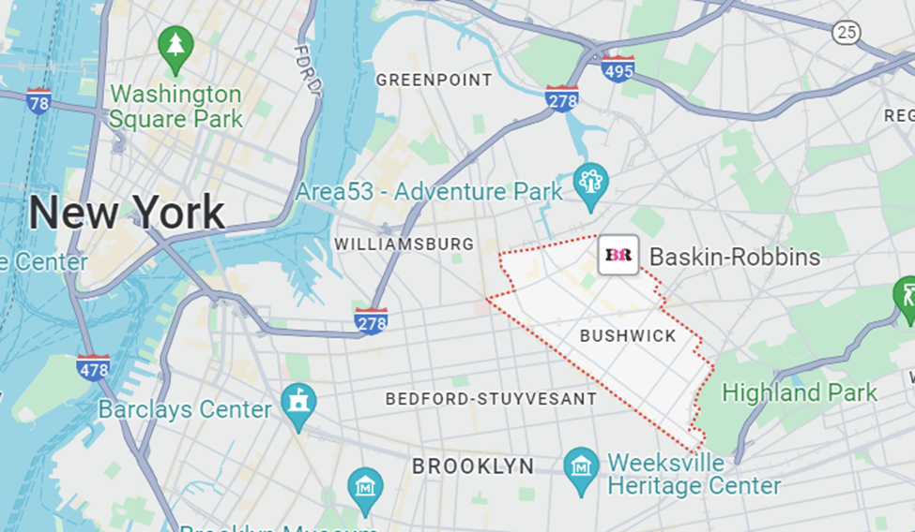
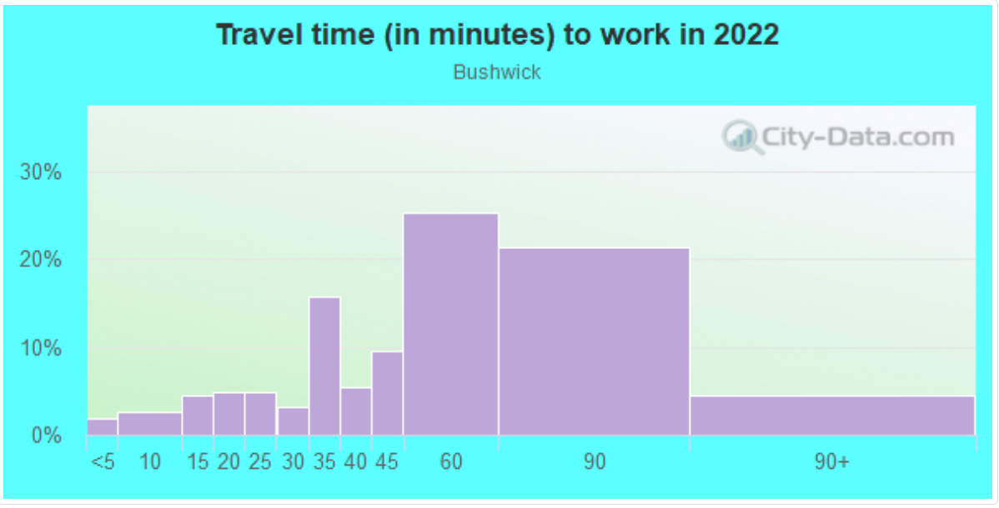
BUSHWICK AN OVERVIEW
REGION: NEW YORK CITY
AREA: Urban, Part of Brooklyn
POPULATION: 114,882
MEDIAN AGE OF THE POPULATION: 32
MEDIAN INCOME: $82,306/year
OCCUPATION: Employees, Students and
creative professionals.

Slide 3
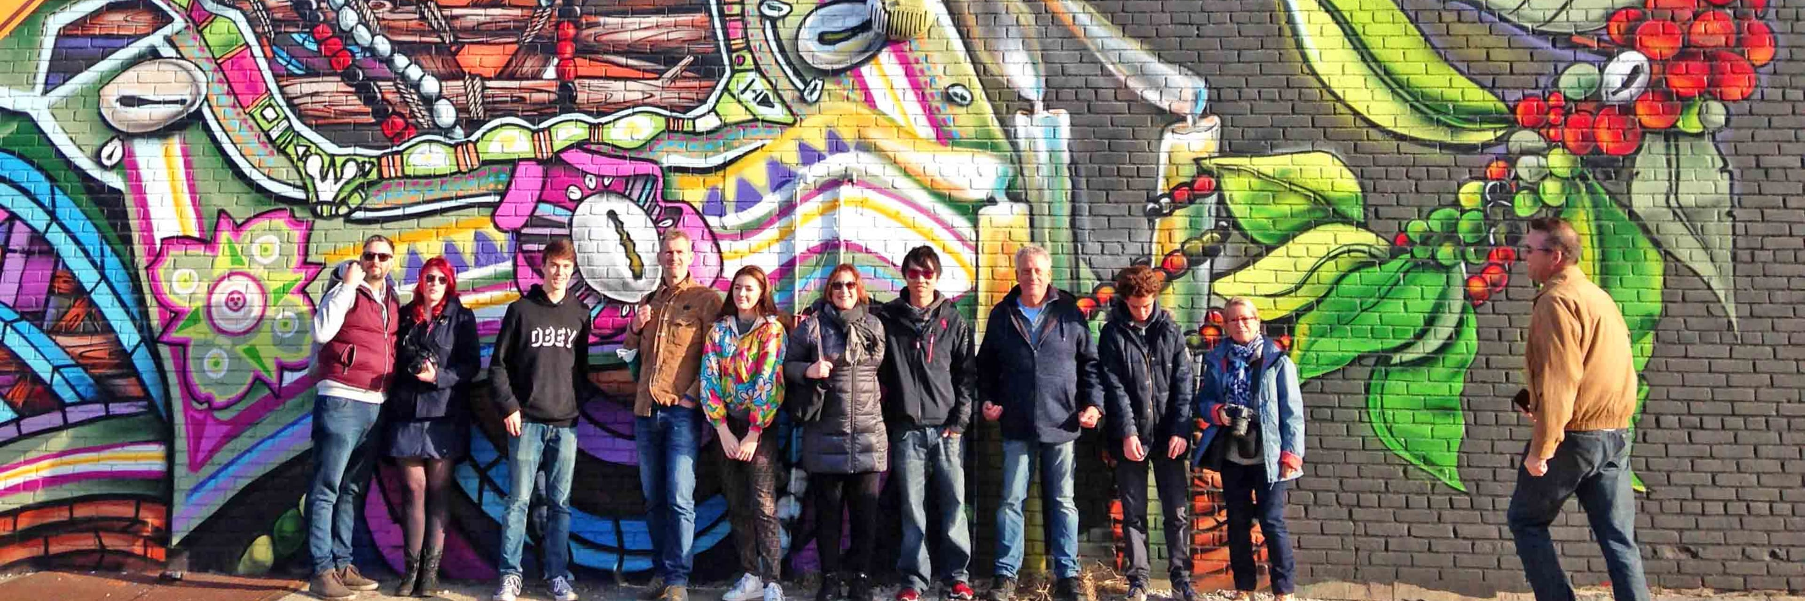
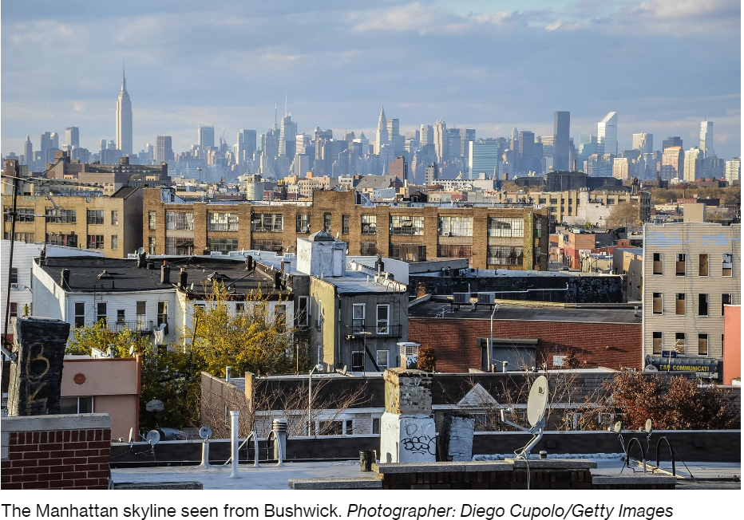
Spotlight on Bushwick: A Prime Real Estate Opportunity
Proximity to Key Areas.
Close to trendy Williamsburg.
Easy access to Manhattan and Queens.
Transformative Growth.
Lower Manhattan and Williamsburg are rapidly gentrifying.
Bushwick is following the trend, attracting new residents and businesses.

Slide 4
DESCRIPTIVE ANALYSIS

Slide 5
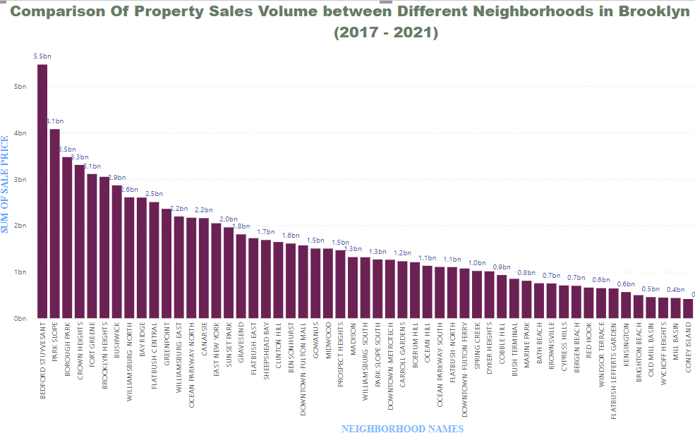

Slide 6
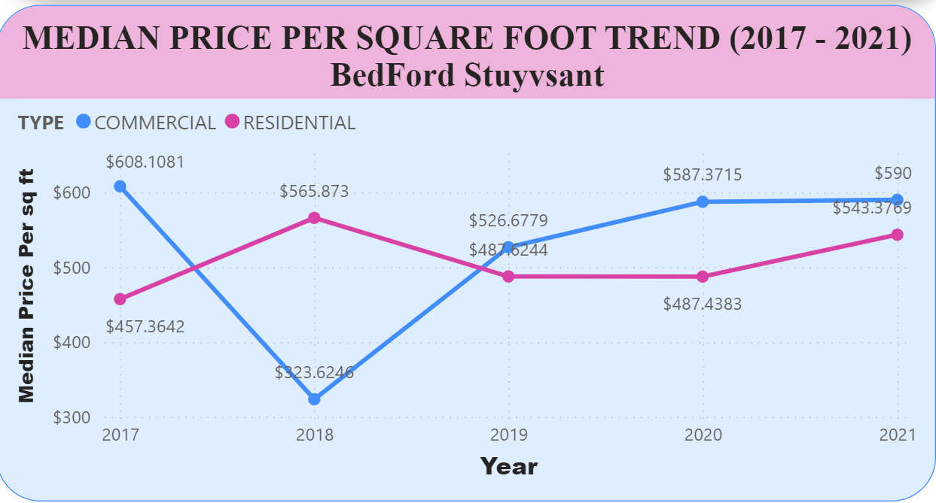
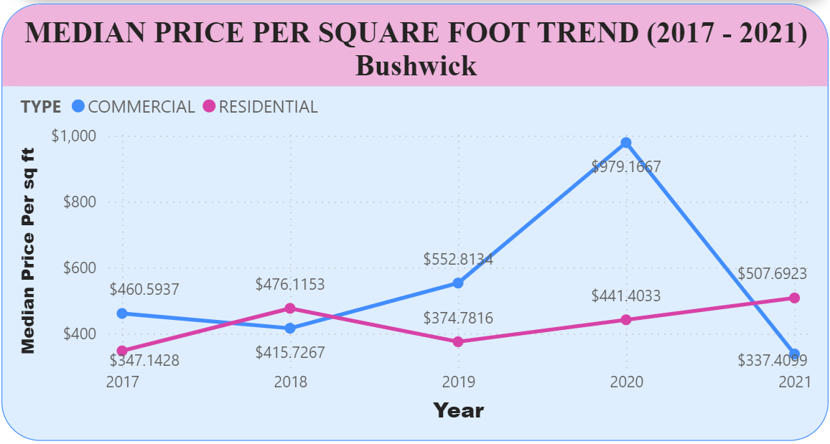
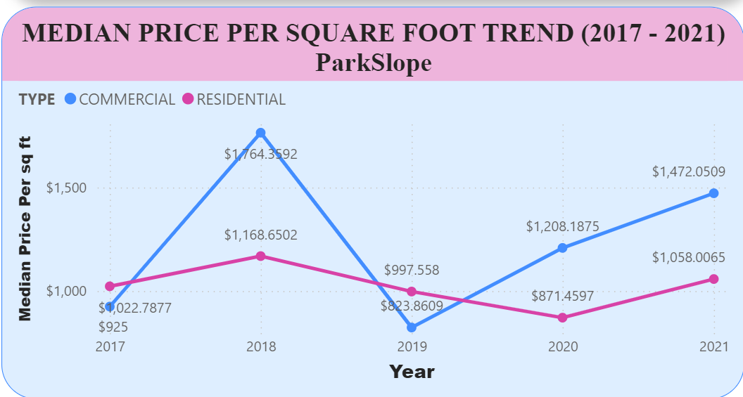
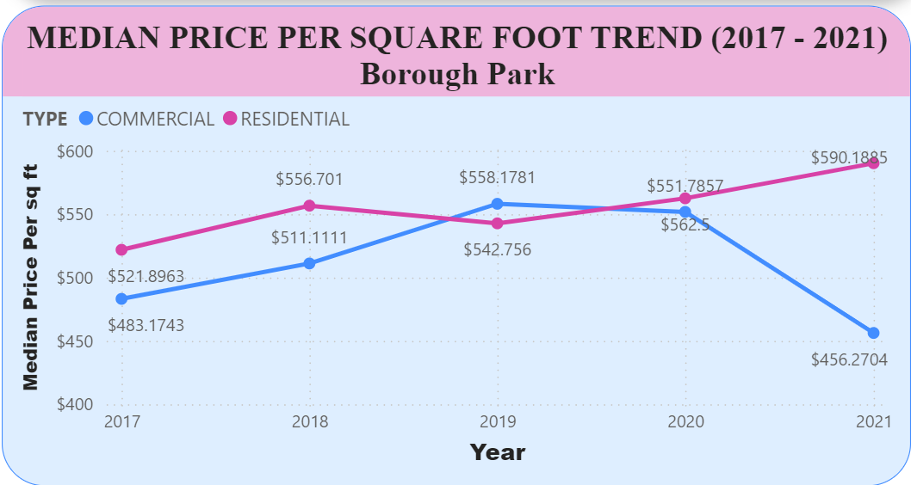
MEDIAN PRICE PER SQUARE FOOT COMPARISON BETWEEN HIGH SALE VOLUME NEIGHBORHOOD

Slide 7
PREDICTIVE ANALYTICS

Slide 8
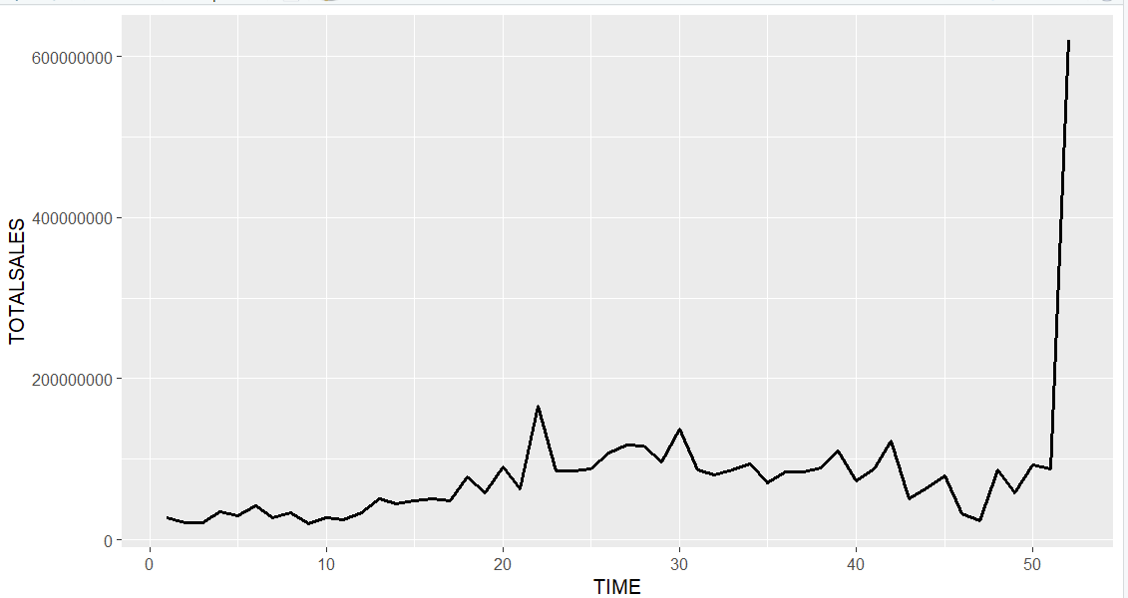
Time series plot of total residential real estate sales 2009 – 2021 Bushwick

Slide 9
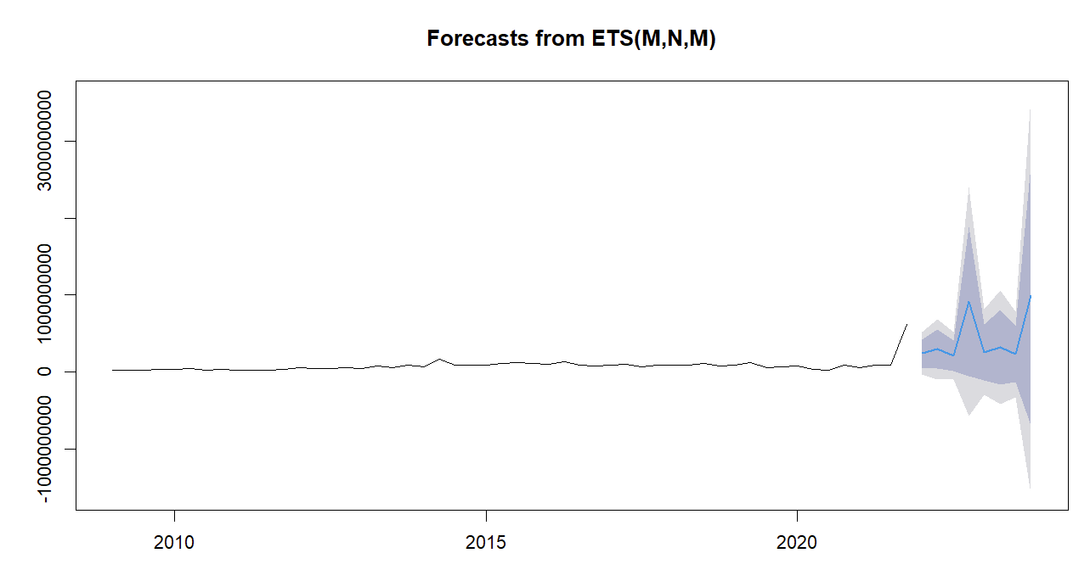
Time series forecast Plot for the next 8 months in Bushwick Using RStudio

Slide 10
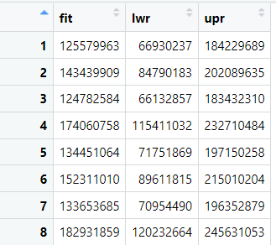
Multiple Regression sales prediction for the next 8 quarters for Bushwick Using RStudio

Slide 11
PRESCRIPTIVE ANALYTICS OPTIMIZATION MODEL

Slide 12
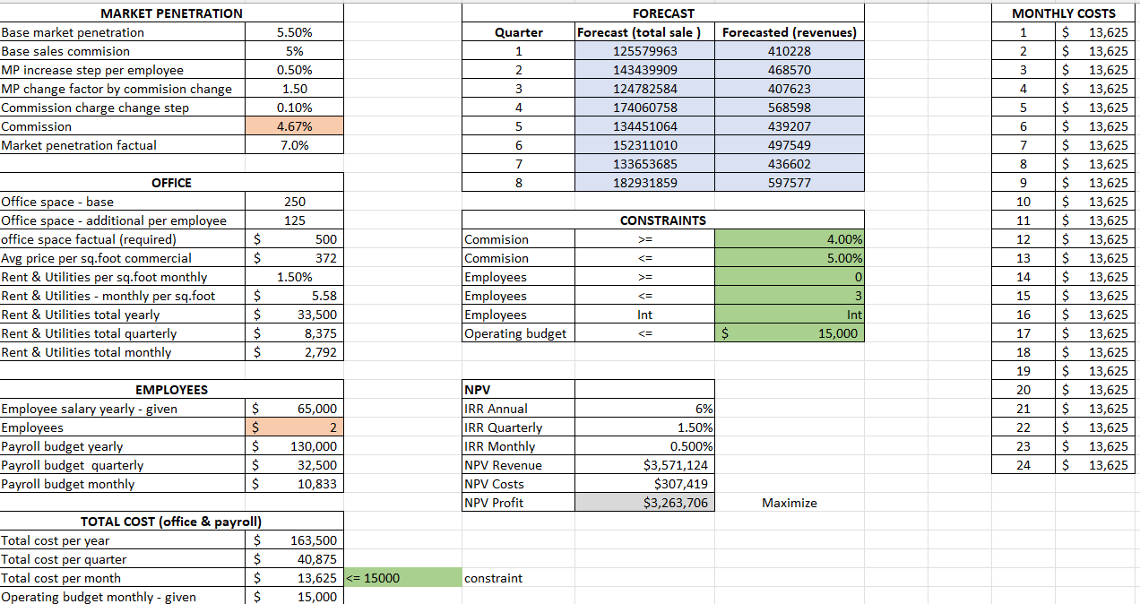
Analysis using Solver in Excel for Strategic Insights on Opening a Real Estate Company in BUSHWICK

Slide 13

Do You Want To Double the Profit? Then Spend a little extra $106 per month than your allotted budget.

Slide 14
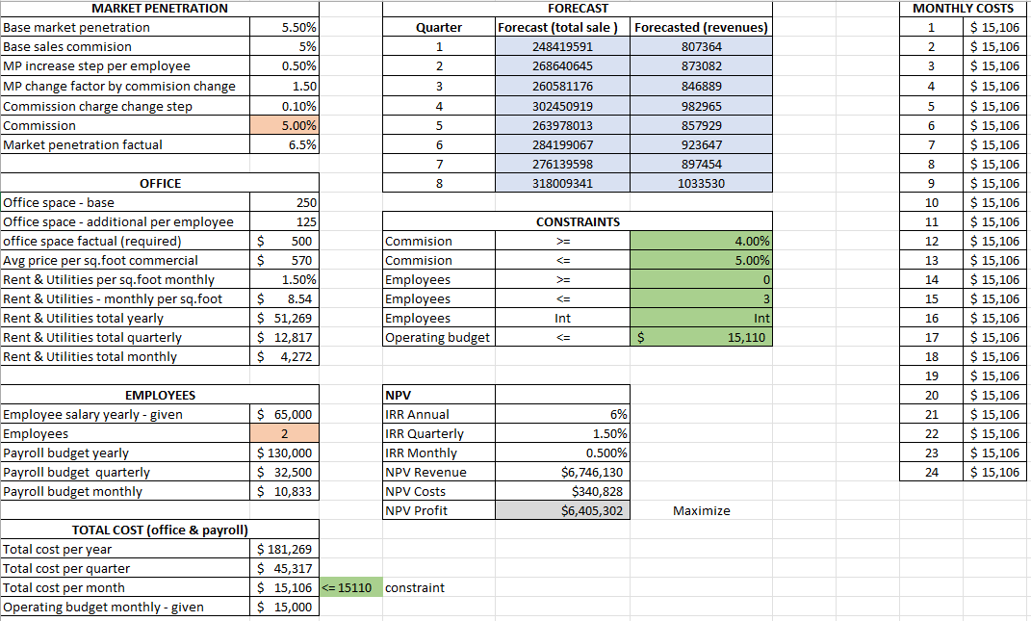
Analysis using Solver in Excel for Strategic Insights on Opening a Real Estate Company in BEDFORD STUYVESANT

Slide 15
Optimization Model Assumptions & Outcomes
• Annual IRR: 6%
Base market penetration: 5.5%
• Influenced by commission charged and employees hired
Base square footage required: 250.
• Will increase by 125 per employee hired
• Rent calculated as 1.5% of the commercial price per sq foot
BUSHWICK
BEDFORD STUYVESANT
Opening a sales office :
• Recommended company commission: 4.67 %
• Recommend hiring two additional employees for a
total office square footage: of 500
• Projected market penetration: 7.0 %
• Monthly operating budget: $13,625
Total NPV of $3.26 M
Opening a sales office:
• Recommended company commission: 5.00 %
• Recommend hiring two additional employees for a
total office square footage: 500
• Projected market penetration: 6.5 %
• Monthly operating budget: $15,106
Total NPV of $6.40 M

Slide 16

RECOMMENDATIONS
I recommend starting the real Estate company in Bushwick for its cost efficiency, scalability, financial viability, and market penetration prospects.
If stakeholders want to double the profit with little flexibility on monthly budget, then BEDFORD STUYVESANT would be a great option.

Slide 17

Thank You!
I am now happy to take any questions you may have

